Slide 1
WRITING YOUR IPQ REPORT
A GUIDE

Slide 2
WORD COUNT
The word-limit for the whole report is 5000 words.
This does not include the appendices, research log, or bibliography.
You may think this is a large word-count, that you’ll never write as many as 5000 words, or that you’ll get everything written with far less than 5000 words.
There is a lot however, that you need to do within this word limit…

Slide 3
JUSTIFY YOUR RESEARCH QUESTION
You need to justify your research question.
Why have you chosen your research question?
Do not just say your interested in the topic!
You need to discuss the importance and relevance of your topic.
The more detailed your justification can be, the better!

Slide 4



Slide 5
JUSTIFY YOUR RESEARCH METHODOLOGY
You need to state clearly how you will research your topic (how you will research is the “methodology”).
It is not enough though, simply to state how you will research your topic, you need to justify your methodology too.
This methodology (like your research question) will need to be justified in detail.
Discuss the strengths of your research methodology.
Where relevant, link the strength of your methodology to specific areas to be researched.

Slide 6
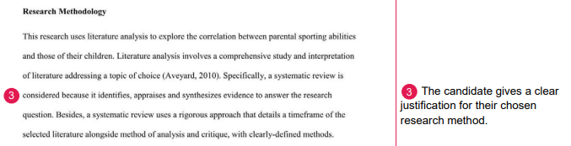
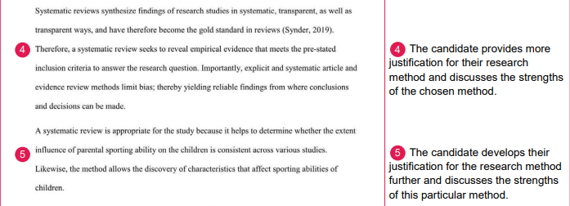

Slide 7
ANSWER THE QUESTION YOU SET YOURSELF!
This may be obvious, but if, for example, your question asks about the cause air pollution in China, but your report was focused specifically, or even mainly on Beijing, have you really answered the question set? No, you have not!
Focus on what the question specifically asks.

Slide 8

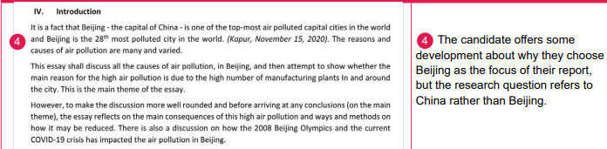

Slide 9
One way to ensure you answer the question set, is to set the research question as the title of your report!
Remember though, to highlight the research question in the first paragraph of your report i.e., right at the very start.
Think also, how to phrase your research question e.g., if your report was on air pollution, which would be the better-phrased question:
- “How can we deal with air pollution?”
OR
- “What is the best way to deal with air pollution?”

Slide 10
ANALYSIS
Analyse the information from your findings/information, and where relevant, link your analysis to the source you got your information from.
Use statistics to illustrate your findings, and analyse these.
You could also discuss here, if appropriate/relevant, whether your findings confirm/prove, expand on, change, or even disprove your initial/previous views and/or hypothesis.

Slide 11
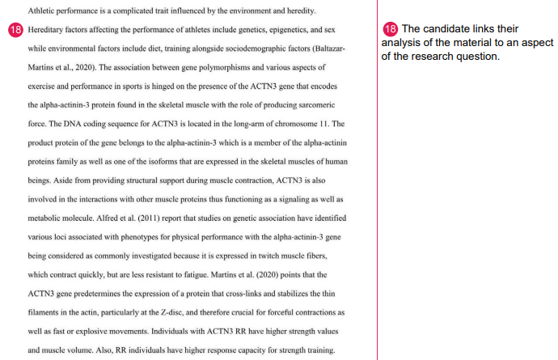

Slide 12
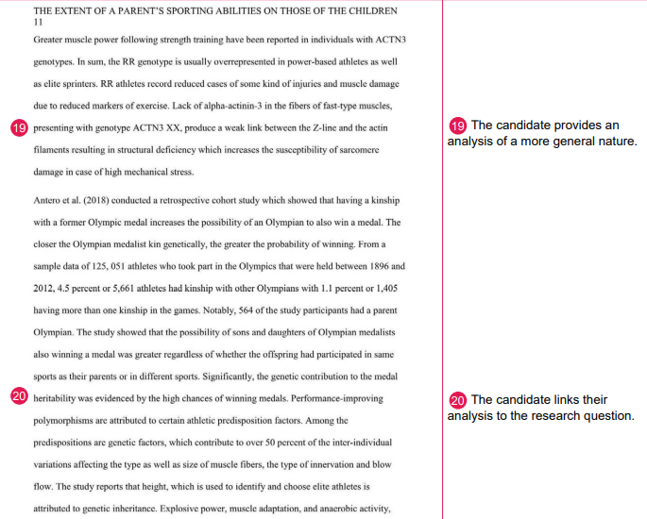

Slide 13
EVALUATE YOUR SOURCES
As well as analysing your sources, you should also evaluate your sources. You can do this as an extension to your analysis. You can also evaluate sources all through your report, and reiterate some of this in your conclusion.
How do the sources influence your answer?
- Are a lot of them from a particular school of thought?
- Might you come to a different conclusion with different sources e.g., from different perspectives?
Ideally, you should have sources from different perspectives, but if these are difficult to come by, you could mention this in the evaluation, and explain why this is, and how this may have influenced/impacted your conclusion/answer to your question.

Slide 14


Slide 15
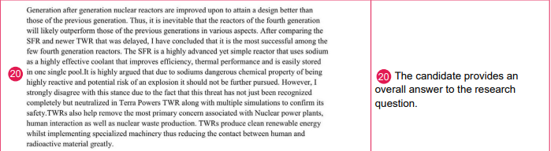
CONCLUSION
Your conclusion should include an actual answer to the question.

Slide 16
REFLECTION
After your conclusion, you should write a reflection.
The reflection can also be another good place to discuss whether your findings confirmed/proved, expanded on, changed, or even disproved your initial/previous views and/or hypothesis.
You should also discuss here the strengths and limitations of your study/research/methodology e.g., the reliability and/or validity of your sources.
Here too, you could consider if the limitations of your research influenced your conclusion, and if maybe a different approach may have led to a different, and possibly more accurate conclusion.

Slide 17


Slide 18
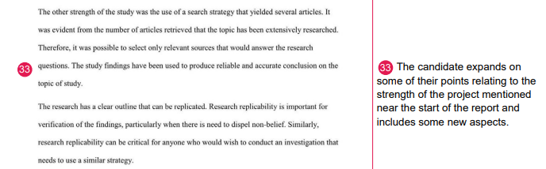
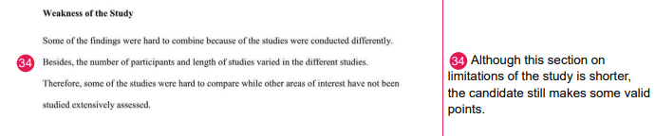

Slide 19
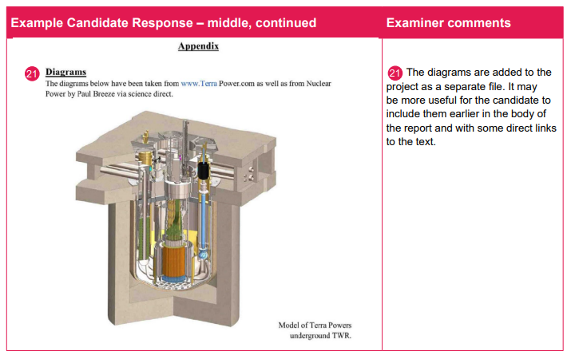
APPENDICES
Use appendices, but think carefully what to put in them.
Some charts and statistics may be good here, but some of these may be better inserted in the main body of the report.

Slide 20
RESEARCH LOG
This is your record of your progress, with what sources you consult, when you consult them, and how they help with your research.
Do not just say what sources you looked at and when, but discuss also how the research and individual sources help your research e.g., provide evidence to support your argument, or even show evidence that disproves your hypothesis (which can happen even in a PhD thesis, or post-doctoral research).
The research log should also show evidence of planning.

Slide 21
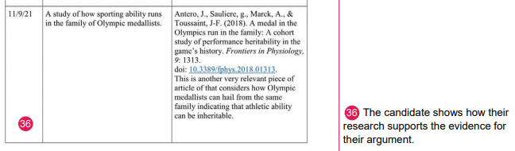
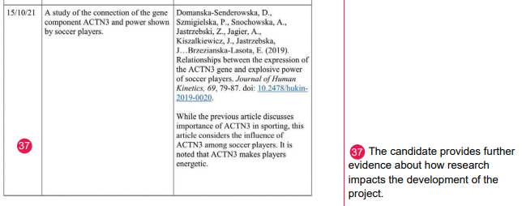


Slide 22
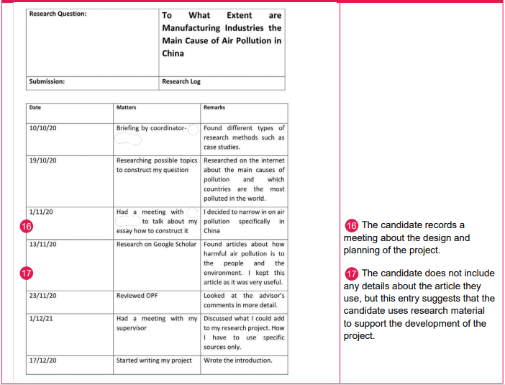

Slide 23
SOURCES
Use suitable sources!
This is an academic paper, so you need to ensure that your sources are suitable for this.
Use a range of academic sources e.g., books, suitable video documentaries, and academic papers.
Do not use Wikipedia. This is okay as a starting point i.e., to help you gain an understanding of the subject material, but do not cite this in your bibliography!
Wikipedia articles should have a bibliography/list of articles for further reading at the end. Some of these articles may be good sources to consult, and would look much better cited in the bibliography.
Media sources, similarly, would merely support more academically rigorous material.
Make sure you include all source details in the bibliography.

Slide 24
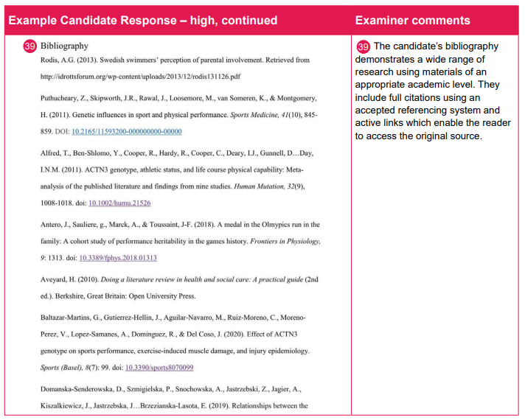

Slide 25
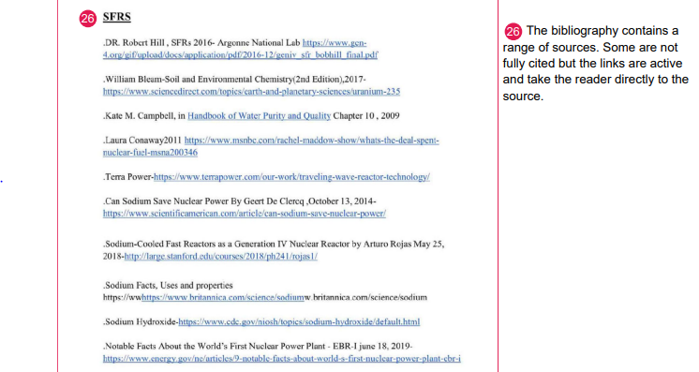

Slide 26
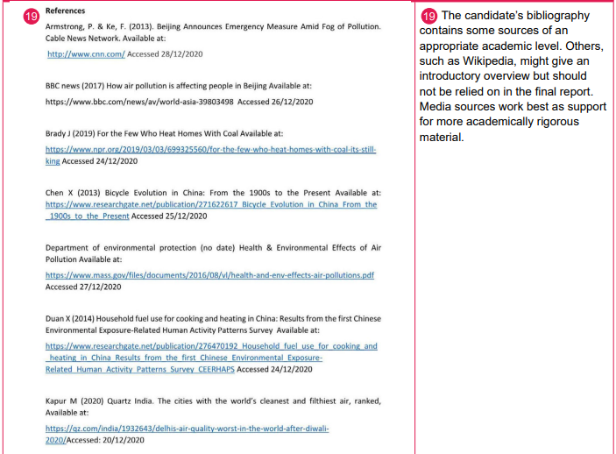

Slide 27
WHAT CAN YOU DO IN YOUR IPQ REPORTS TO JUSTIFY YOUR QUESTIONS AND RESEARCH METHODS?
How well have you justified your research question?
How well have you justified your research methods?
What can you do to improve either/both of these?
Discuss in pairs/threes

Slide 28
SOME FINAL TIPS/REMINDERS…
Make sure you regularly check the criteria, and address each part this with each part of your report.
Make sure your question matches the focus of the report/vice-versa.
Include analysis and evaluation
Include data, where appropriate/relevant

Slide 29
GRADING CRITERIA
Below is the grading criteria by which your IPQ reports will be assessed.
You should refer to this as you progress and do the best you can to score as highly on the grading criteria as you can.

Slide 30
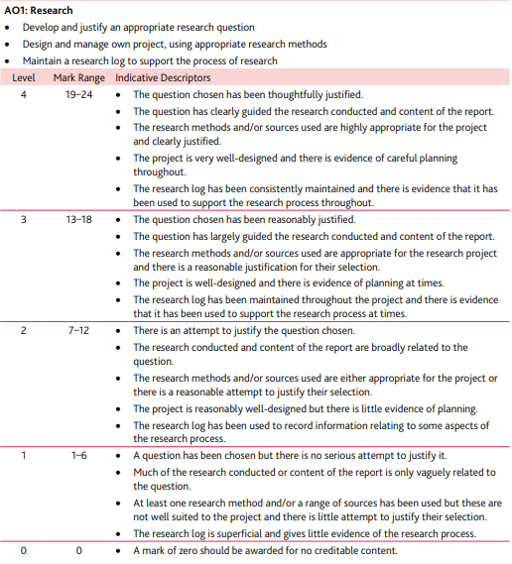

Slide 31
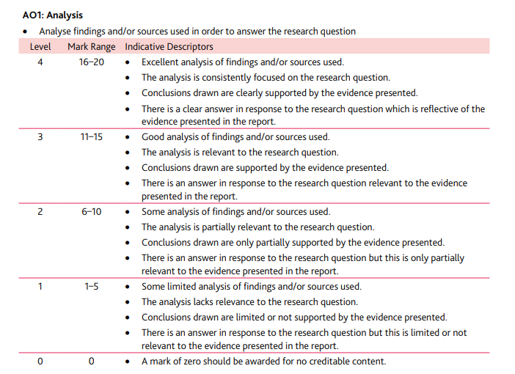

Slide 32
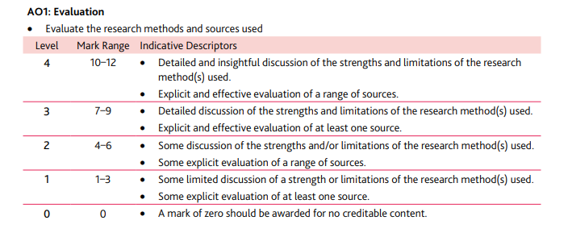

Slide 33
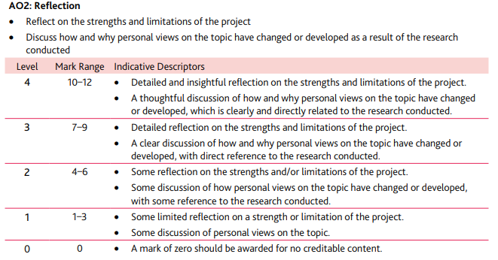

Slide 34
